Slide 1
TITLE:UNIFIED APP FOR FOOTBALL CLUB MANAGEMENT SYSTEM
NAME: GABRIEL E. MOSHA
REG NO: 14322074/T.21

Slide 2
Problem background
Football clubs, encompasses various tasks like player registration and management, player financial management, fan engagement, match tracking
Most football clubs handle the activities and clubs information traditional like spreadsheets, emails and paper-based systems

Slide 3
Problem Statement
Football clubs lack important modules to effectively track and manage their daily activities such as, financial management, fan engagement, player status, communication, and collaboration. Football clubs struggle to accurately track, analyses and schedule improved club management such as financial management, fan engagement, leading to poor decision making and internal conflicts. Football clubs manage, track and analyses player status, financial management, engagement with fans inadequately due to lack of proper system for managing their decision and football activities.

Slide 4
Overall and Specific Objectives
General objective
The main objective of this project is to develop a user-friendly system dedicated to football club management: This will offer a comprehensive information on clubs such as player management, financial management, fan engagement and team management
Specific objectives
To analysis the challenges of existing similar system by looking the gapes between existing system and expected system
To gather user requirements to understand specific needs and preferences of both customers and administrators.
To design the physical and conceptual model design.

Slide 5
Significance of the Project
Strengthens fan engagement
Improved communication and collaboration
Improved operational efficiency

Slide 6
Scope of the Project
1.This project will involve designing database, user friendly interface and system functionalities.
2.Also the project will focus on developing and implementing unified application for football club management system to keep track of basic clubs information like financial management, fan engagement, team management

Slide 7
Related Systems with their strengths and weakness
i. Teambuilding Software
strengths
Comprehensive player management
Communication and collaboration
weaknesses
Limited security features

Slide 8
Cont…
ii. Sports Connect Software
strengths
Marketing and promotion tools
Mobile app-user-friendly mobile app for easy access
weakness
Limited core management features

Slide 9
Methodology
1.Agile methodology
its strengths
i. Iterative development
ii. Adaptabilitity

Slide 10
Functional requirements
The system should allow team manager to register, add players, add financial record, view and provide feedback
The system must allow an admin to approve staffs, users
The system should include features for managing users or fans to provide feedback
The system should provide feature for financial management

Slide 11
Non functional requirements
Usability
Performance
Scalability
Reliability
Security
maintainability

Slide 12
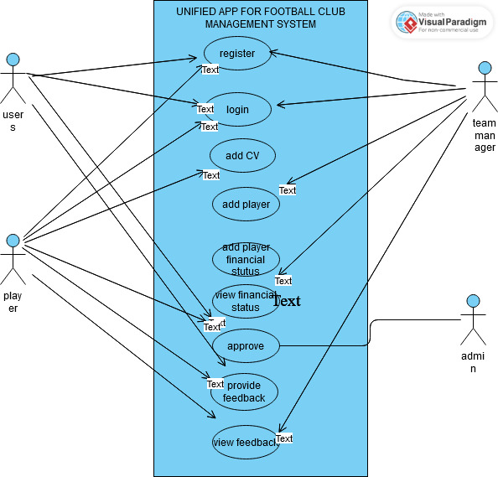
Use case diagram

Slide 13
Conclusion
Thanks for listening

